Slide 1
Data Mining:
Concepts and Techniques
(3rd ed.)
— Chapter 5 —
Jiawei Han, Micheline Kamber, and Jian Pei
University of Illinois at Urbana-Champaign &
Simon Fraser University
©2013 Han, Kamber & Pei. All rights reserved.
1
1
Notes:
1

Slide 2
Chapter 5: Data Cube Technology
Data Cube Computation: Preliminary Concepts
Data Cube Computation Methods
Processing Advanced Queries by Exploring Data Cube Technology
Multidimensional Data Analysis in Cube Space
Summary
2
2
Notes:
2

Slide 3
Data Cube: A Lattice of Cuboids
all
0-D(apex) cuboid
time
item
location
supplier
1-D cuboids
time,location
item,location
location,supplier
2-D cuboids
time,item
time,supplier
item,supplier
time,location,supplier
3-D cuboids
time,item,location
time,item,supplier
item,location,supplier
4-D(base) cuboid
time, item, location, supplierc
3
3
Notes:
3

Slide 4
Data Cube: A Lattice of Cuboids
all
0-D(apex) cuboid
time
item
location
supplier
1-D cuboids
time,item
time,location
item,location
location,supplier
time,supplier
item,supplier
2-D cuboids
time,location,supplier
3-D cuboids
time,item,location
time,item,supplier
item,location,supplier
time, item, location, supplier
4-D(base) cuboid
Base vs. aggregate cells; ancestor vs. descendant cells; parent vs. child cells
  (9/15, milk, Urbana, Dairy_land)
  (9/15, milk, Urbana, *)
  (*, milk, Urbana, *)
  (*, milk, Urbana, *)
  (*, milk, Chicago, *)
  (*, milk, *, *)
4

Slide 5

Cube Materialization:
Full Cube vs. Iceberg Cube
Full cube vs. iceberg cube
    compute cube sales iceberg as
    select month, city, customer group, count(*)
    from salesInfo
    cube by month, city, customer group
    having count(*) >= min support
iceberg condition
Computing only the cuboid cells whose measure satisfies the iceberg condition
Only a small portion of cells may be “above the water’’ in a sparse cube
Avoid explosive growth: A cube with 100 dimensions
  2 base cells: (a₁, a₂, …., a₁₀₀), (b₁, b₂, …, b₁₀₀)
  How many aggregate cells if “having count >= 1”?
  What about “having count >= 2”?
5
5
Notes:
5
2*(2^{100}-1)-1, 1
Explanation: one cell, such as (a1, a2, …., a100) generates 2^100 -1 aggregate cells, because choose(100 1) + choose (100 2) + ... choose (100, 100) = 2^100 - 1 aggregate cells.
For two cell question, it generates 2 * (2^100-1) -1 distinct aggregate cells because (*, *, …, *) generated by (a1, a2, …., a100) and (b1, b2, …, b100) will be merged into one cell:
(*, *, …, *): 2. Hence we have 2*(2^{100}-1)-1

Slide 6
Iceberg Cube, Closed Cube & Cube Shell
Is iceberg cube good enough?
  2 base cells: {(a₁, a₂, a₃ . . . , a₁₀₀):10, (a₁, a₂, b₃, . . . , b₁₀₀):10}
  How many cells will the iceberg cube have if having count(*) >= 10? Hint: A huge but tricky number!
Close cube:
  Closed cell c: if there exists no cell d, s.t. d is a descendant of c, and d has the same measure value as c.
  Closed cube: a cube consisting of only closed cells
  What is the closed cube of the above base cuboid? Hint: only 3 cells
Cube Shell
  Precompute only the cuboids involving a small # of dimensions, e.g., 3
  More dimension combinations will need to be computed on the fly
For (A₁, A₂, … A₁₀), how many combinations to compute?
6
Notes:
If the two base cells were: {(a₁, a₂, a₃ . . . , a₁₀₀):10, (b₁, b₂, b₃, . . . , b₁₀₀):10}, the total # of non-base cells should be 2 * 2^{100} – 3.
But for {(a₁, a₂, a₃ . . . , a₁₀₀):10, (a₁, a₂, b₃, . . . , b₁₀₀):10}, the total # of non-base cells should be 2 * 2^{100} – 6.

Slide 7
General Heuristics (Agarwal et al. VLDB’96)
Sorting, hashing, and grouping operations are applied to the dimension attributes in order to reorder and cluster related tuples
Aggregates may be computed from previously computed aggregates, rather than from the base fact table
  Smallest-child: computing a cuboid from the smallest, previously computed cuboid
  Cache-results: caching results of a cuboid from which other cuboids are computed to reduce disk I/Os
  Amortize-scans: computing as many as possible cuboids at the same time to amortize disk reads
  Share-sorts: sharing sorting costs cross multiple cuboids when sort-based method is used
  Share-partitions: sharing the partitioning cost across multiple cuboids when hash-based algorithms are used
7
7
Notes:
7

Slide 8
Chapter 5: Data Cube Technology
Data Cube Computation: Preliminary Concepts
Data Cube Computation Methods
  Multi-Way Array Aggregation
  BUC
  High-Dimensional OLAP
Processing Advanced Queries by Exploring Data Cube Technology
Multidimensional Data Analysis in Cube Space
Summary
8
8
Notes:
8

Slide 9
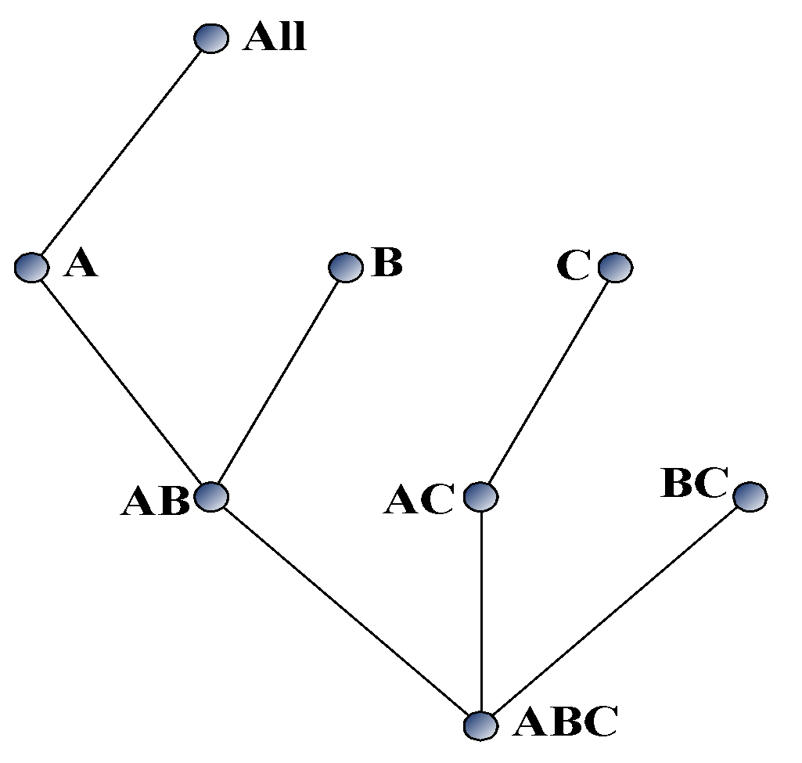
Multi-Way Array Aggregation
Array-based “bottom-up” algorithm
Using multi-dimensional chunks
No direct tuple comparisons
Simultaneous aggregation on multiple dimensions
Intermediate aggregate values are re-used for computing ancestor cuboids
Cannot do Apriori pruning: No iceberg optimization
9
9
Notes:
9

Slide 10
Multi-way Array Aggregation for Cube Computation (MOLAP)
Partition arrays into chunks (a small subcube which fits in memory).
Compressed sparse array addressing: (chunk_id, offset)
Compute aggregates in “multiway” by visiting cube cells in the order which minimizes the # of times to visit each cell, and reduces memory access and storage cost.
C
c3
61
62
63
64
c2
45
46
47
48
c1
29
30
31
32
What is the best traversing order to do multi-way aggregation?
c 0
B
60
b3
13
14
15
16
44
9
28
56
b2
B
40
24
52
b1
5
36
20
b0
1
2
3
4
a0
a1
a2
a3
10
A
10
Notes:
10

Slide 11
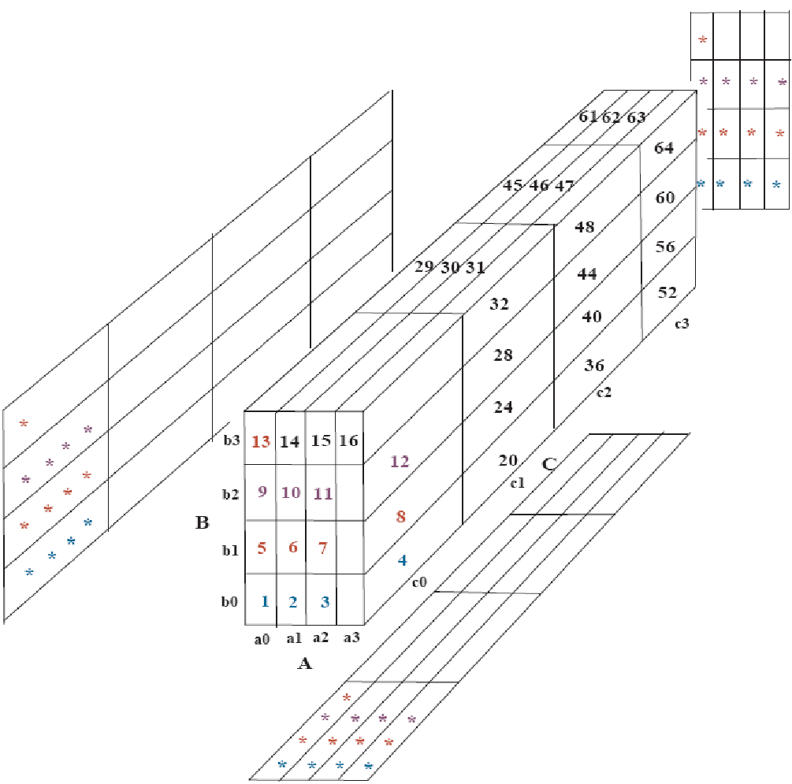

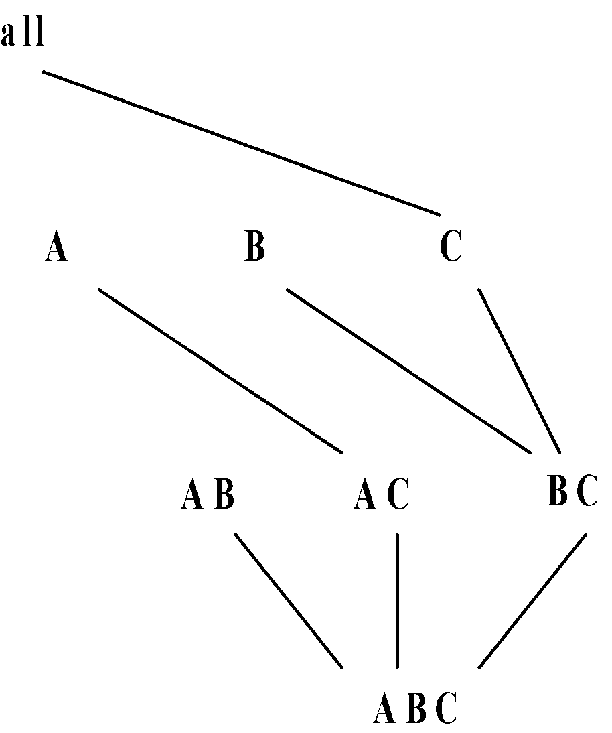
Multi-way Array Aggregation for Cube Computation (3-D to 2-D)
The best order is the one that minimizes the memory requirement and reduced I/Os
11

Slide 12
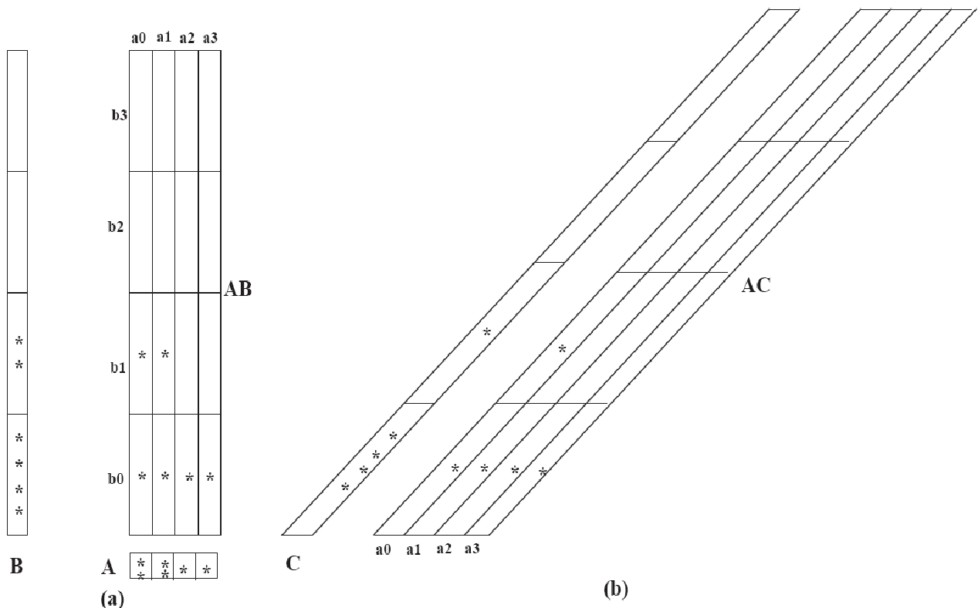

Multi-way Array Aggregation for Cube Computation (2-D to 1-D)
12

Slide 13
Multi-Way Array Aggregation for Cube Computation (Method Summary)
Method: the planes should be sorted and computed according to their size in ascending order
  Idea: keep the smallest plane in the main memory, fetch and compute only one chunk at a time for the largest plane
Limitation of the method: computing well only for a small number of dimensions
  If there are a large number of dimensions, “top-down” computation and iceberg cube computation methods can be explored
13
13
Notes:
13

Slide 14
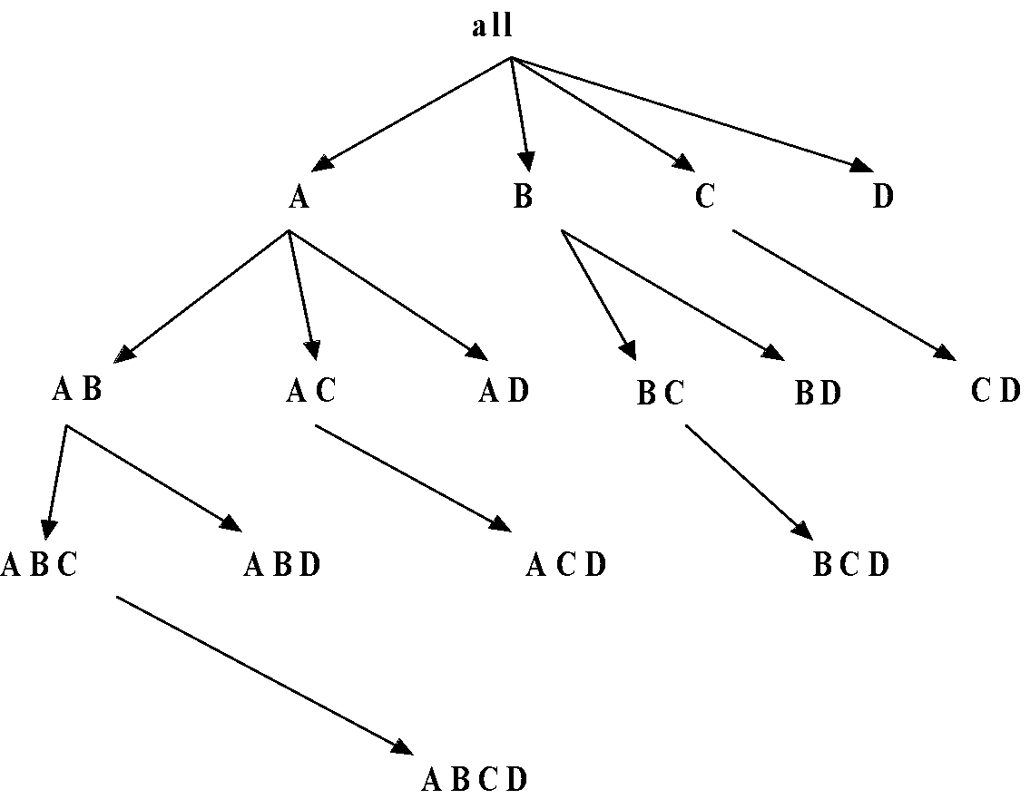
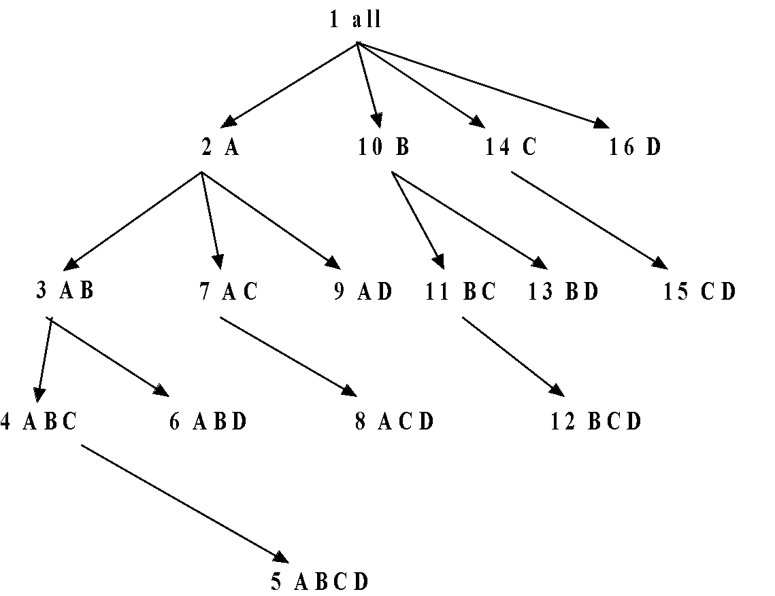
Bottom-Up Computation (BUC)
BUC (Beyer & Ramakrishnan, SIGMOD’99)
Bottom-up cube computation
  (Note: top-down in our view!)
Divides dimensions into partitions and facilitates iceberg pruning
  If a partition does not satisfy min_sup, its descendants can be pruned
  If minsup = 1 ⇒ compute full CUBE!
No simultaneous aggregation
14
14
Notes:
14

Slide 15
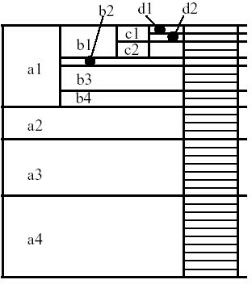
BUC: Partitioning
Usually, entire data set can’t fit in main memory
Sort distinct values
  partition into blocks that fit
Continue processing
Optimizations
  Partitioning
    External Sorting, Hashing, Counting Sort
  Ordering dimensions to encourage pruning
    Cardinality, Skew, Correlation
  Collapsing duplicates
    Can’t do holistic aggregates anymore!
15
15
Notes:
15

Slide 16
Properties of Proposed Method
Partitions the data vertically
Reduces high-dimensional cube into a set of lower dimensional cubes
Online re-construction of original high-dimensional space
Lossless reduction
Offers tradeoffs between the amount of pre-processing and the speed of online computation
16
16
Notes:
16

Slide 17
Example: Computing a 5-D Cube with Two Shell Fragments
Let the cube aggregation function be count
Divide the 5-D table into 2 shell fragments: (A, B, C) and (D, E)
Build traditional invert index or RID list
Attribute Value | TID List | List Size
a1 | 1 2 3 | 3
a2 | 4 5 | 2
b1 | 1 4 5 | 3
b2 | 2 3 | 2
c1 | 1 2 3 4 5 | 5
d1 | 1 3 4 5 | 4
d2 | 2 | 1
e1 | 1 2 | 2
e2 | 3 4 | 2
e3 | 5 | 1
tid | A | B | C | D | E
1 | a1 | b1 | c1 | d1 | e1
2 | a1 | b2 | c1 | d2 | e1
3 | a1 | b2 | c1 | d1 | e2
4 | a2 | b1 | c1 | d1 | e2
5 | a2 | b1 | c1 | d1 | e3
17
17
Notes:
17

Slide 18


Shell Fragment Cubes: Ideas
Generalize the 1-D inverted indices to multi-dimensional ones in the data cube sense
Compute all cuboids for data cubes ABC and DE while retaining the inverted indices
For example, shell fragment cube ABC contains 7 cuboids:
  A, B, C
  AB, AC, BC
  ABC
This completes the offline computation stage
Cell
Intersection
TID List
List Size
a1 b1
1 2 3 1 4 5
1
1
a1 b2
1 2 3 2 3
2 3
2
a2 b1
4 5 1 4 5
4 5
2
a2 b2
4 5 2 3
0
18
18
Notes:
18

Slide 19
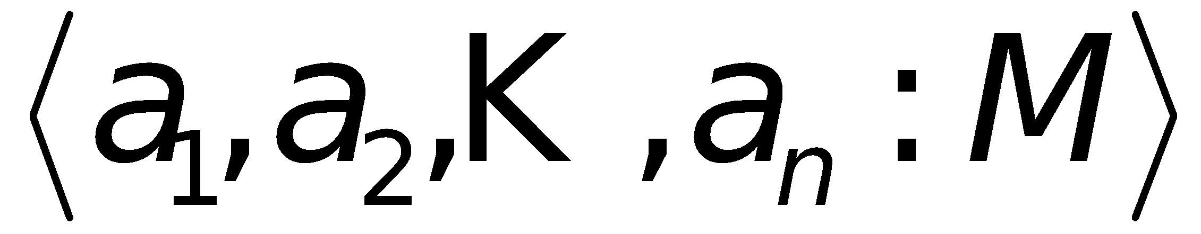

Online Query Computation: Query
A query has the general form
Each a_{i} has 3 possible values
  Instantiated value
  Aggregate * function
  Inquire ? function
For example, returns a 2-D data cube.
19
19
Notes:
19

Slide 20
Online Query Computation: Method
Given the fragment cubes, process a query as follows
  Divide the query into fragment, same as the shell
  Fetch the corresponding TID list for each fragment from the fragment cube
  Intersect the TID lists from each fragment to construct instantiated base table
  Compute the data cube using the base table with any cubing algorithm
20
20
Notes:
20

Slide 21
Online Query Computation: Sketch
A | B | C | D | E | F | G | H | I | J | K | L | M | N | …
Instantiated
Base Table
Online
Cube
21
21
Notes:
21

Slide 22
Chapter 5: Data Cube Technology
Data Cube Computation: Preliminary Concepts
Data Cube Computation Methods
  Processing Advanced Queries by Exploring Data Cube Technology
    Sampling Cube: X. Li, J. Han, Z. Yin, J.-G. Lee, Y. Sun, “Sampling Cube: A Framework for Statistical OLAP over Sampling Data”, SIGMOD’08
Multidimensional Data Analysis in Cube Space
Summary
22
22
Notes:
22

Slide 23
Statistical Surveys and OLAP
Statistical survey: A popular tool to collect information about a population based on a sample
  Ex.: TV ratings, US Census, election polls
A common tool in politics, health, market research, science, and many more
An efficient way of collecting information (Data collection is expensive)
Many statistical tools available, to determine validity
  Confidence intervals
  Hypothesis tests
OLAP (multidimensional analysis) on survey data
  highly desirable but can it be done well?
23
23
Notes:
23
23

Slide 24

Surveys: Sample vs. Whole Population
Data is only a sample of population
Age\Education | High-school | College | Graduate
18
19
20
…
24
24
Notes:
24
24

Slide 25

Problems for Drilling in Sampling Cube
OLAP on Survey (i.e., Sampling) Data
Semantics of query is unchanged, but input data is changed
Age/Education | High-school | College | Graduate
18
19
20
…
Data is only a sample of population but samples could be small when drilling to certain multidimensional space
25
25
Notes:
25
25

Slide 26
Challenges for OLAP on Sampling Data
Q: What is the average income of 19-year-old high-school students?
A: Returns not only query result but also confidence interval
Computing confidence intervals in OLAP context
No data?
  Not exactly. No data in subspaces in cube
  Sparse data
  Causes include sampling bias and query selection bias
Curse of dimensionality
  Survey data can be high dimensional
  Over 600 dimensions in real world example
  Impossible to fully materialize
26
26
Notes:
26
26

Slide 27
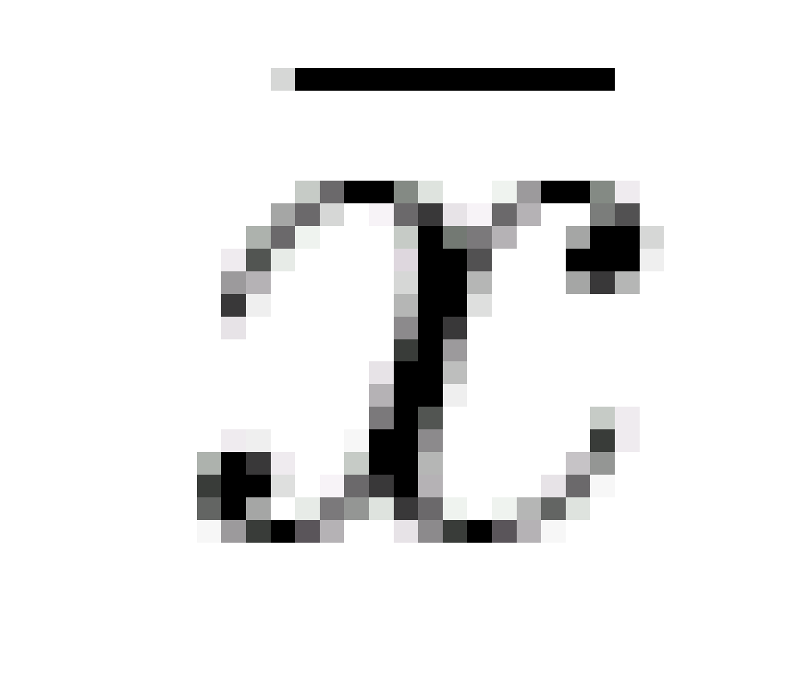


Confidence Interval
  Confidence interval at :
    x is a sample of data set; is the mean of sample
    t_{c} is the critical t-value, calculated by a look-up
    is the estimated standard error of the mean
  Example: $50,000 ± $3,000 with 95% confidence
    Treat points in cube cell as samples
    Compute confidence interval as traditional sample set
Return answer in the form of confidence interval
    Indicates quality of query answer
    User selects desired confidence interval
27
27
Notes:
27

Slide 28
Boosting Confidence by Query Expansion
From the example: The queried cell “19-year-old college students” contains only 2 samples
Confidence interval is large (i.e., low confidence). why?
  Small sample size
  High standard deviation with samples
Small sample sizes can occur at relatively low dimensional selections
  Collect more data?― expensive!
  Use data in other cells? Maybe, but have to be careful
28
28
Notes:
28
28

Slide 29
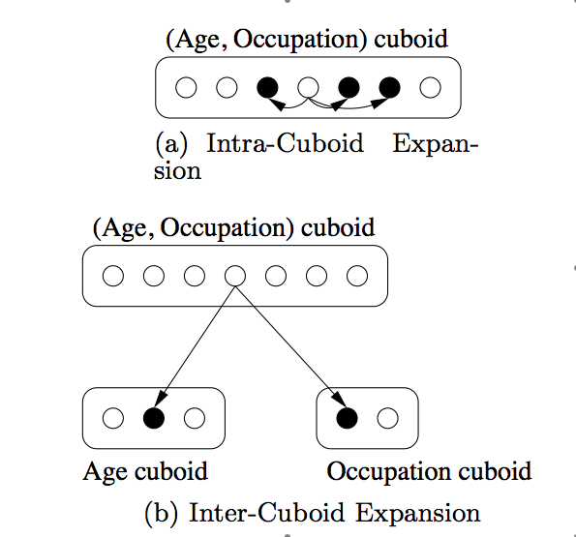
Query Expansion: Intra-Cuboid Expansion
Intra-Cuboid Expansion
Combine other cells’ data into own to “boost” confidence
  If share semantic and cube similarity
  Use only if necessary
  Bigger sample size will decrease confidence interval
Cell segment similarity
  Some dimensions are clear: Age
  Some are fuzzy: Occupation
  May need domain knowledge
Cell value similarity
  How to determine if two cells’ samples come from the same population?
  Two-sample t-test (confidence-based)
29
29
Notes:
29
29

Slide 30
Intra-Cuboid Expansion
What is the average income of 19-year-old college students?
Age/Education | High-school | College | Graduate
18
19
20
…
Expand query to include 18 and 20 year olds? Vs. expand query to include high-school and graduate students?
30
30
Notes:
30
30

Slide 31
Query Expansion: Inter-Cuboid Expansion
If a query dimension is
    Not correlated with cube value
    But is causing small sample size by drilling down too much
Remove dimension (i.e., generalize to *) and move to a more general cuboid
Can use two-sample t-test to determine similarity between two cells across cuboids
Can also use a different method to be shown later
31
31
Notes:
31
31

Slide 32
Chapter 5: Data Cube Technology
Data Cube Computation: Preliminary Concepts
Data Cube Computation Methods
Processing Advanced Queries by Exploring Data Cube Technology
Multidimensional Data Analysis in Cube Space
Summary
32
32
Notes:
32

Slide 33
Data Mining in Cube Space
Data cube greatly increases the analysis bandwidth
Four ways to interact OLAP-styled analysis and data mining
  Using cube space to define data space for mining
  Using OLAP queries to generate features and targets for mining, e.g., multi-feature cube
  Using data-mining models as building blocks in a multi-step mining process, e.g., prediction cube
  Using data-cube computation techniques to speed up repeated model construction
    Cube-space data mining may require building a model for each candidate data space
    Sharing computation across model-construction for different candidates may lead to efficient mining
33

